Slide 1
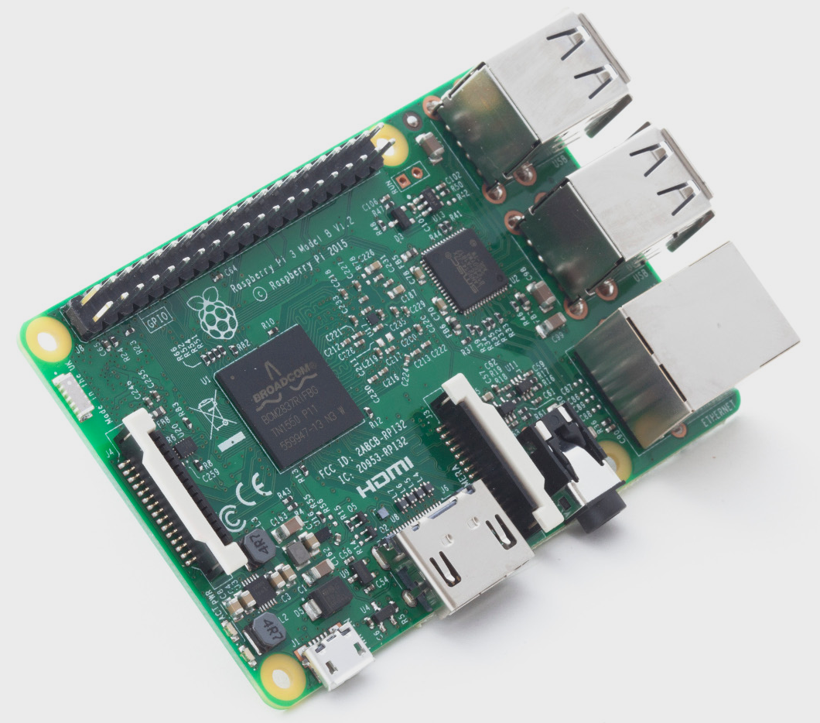
Raspberry Pi 3 Model B
Waikato Linux User Group
27 March 2017
William McKee
Ian Stewart

Slide 2
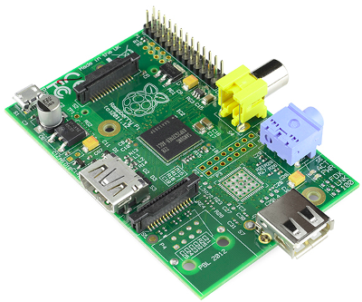
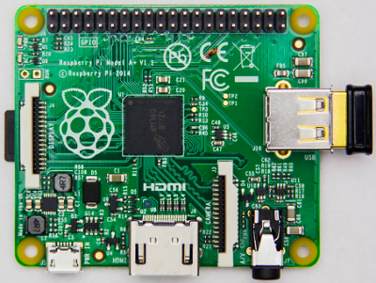
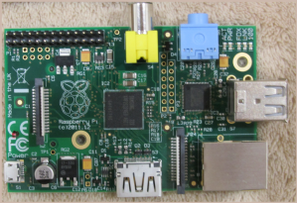
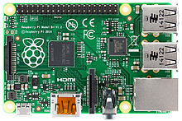
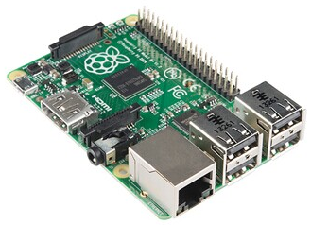
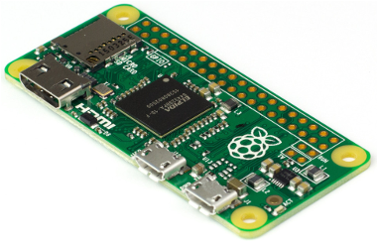
Overview of Raspberry Pi Hardware
Models of Raspberry Pi's (as of Dec 2015).
R-Pi 1 Model A
R-Pi 1 Model B
R-Pi 1 Model A+
BCM2835 – 700MHz 256-512MB
BCM2835 – 700MHz 256~512MB
BCM2835 – 700MHz 512MB
R-Pi 1 Model B+
R-Pi 2 Model B
R-Pi Zero
BCM2835 – 700MHz 512MB
BCM2836C – 900MHz 1GB
BCM2835 – 1GHz 512MB

Slide 3
Raspberry Pi 3 - History
Raspberry Pi 3 Model B – Enhancement of R-Pi 2 Model B
Release date: 29 February 2016; 1 year ago
SoC: Broadcom BCM2837
CPU: 1.2 GHz 64/32-bit quad-core ARM Cortex-A53
Memory: 1 GB LPDDR2 RAM at 900 MHz
Improvements:
    On-board WiFi
    On-board Bluetooth
    USB Boot capabilities.
    Graphics Broadcom VideoCore IV at higher clock frequencies (300 MHz & 400 MHz)
    CPU 1.2GHz 64/32 bit. Pi 2 900MHz 32 bit
Power 10W. i.e. 2A at 5V
Latest: 28 February 2017, the Raspberry PI Zero W

Slide 4
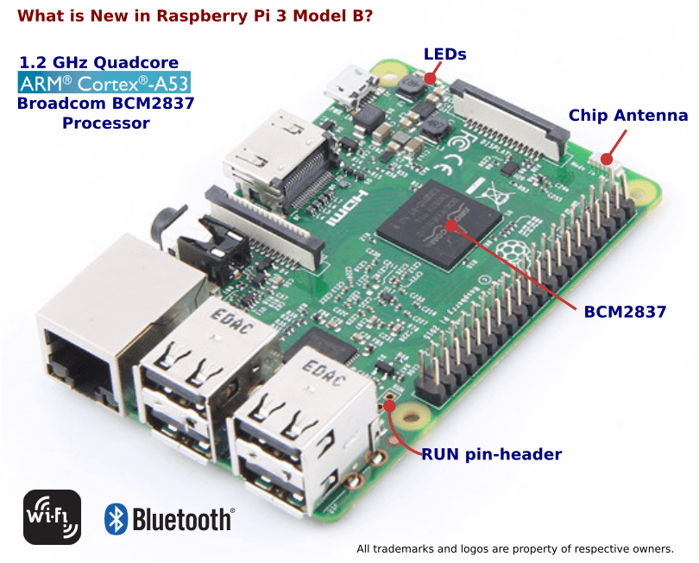
Raspberry Pi 3

Slide 5
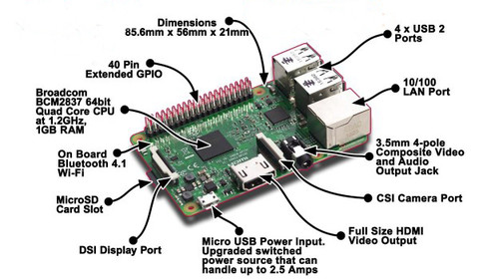
Raspberry Pi 3

Slide 6
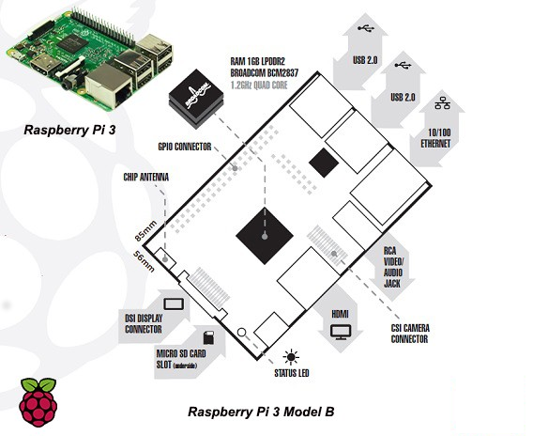
Raspberry Pi 3

Slide 7
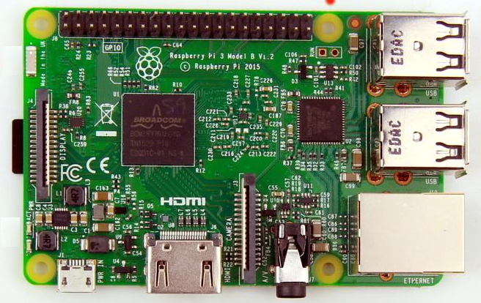
Raspberry Pi 3 - Topside

Slide 8
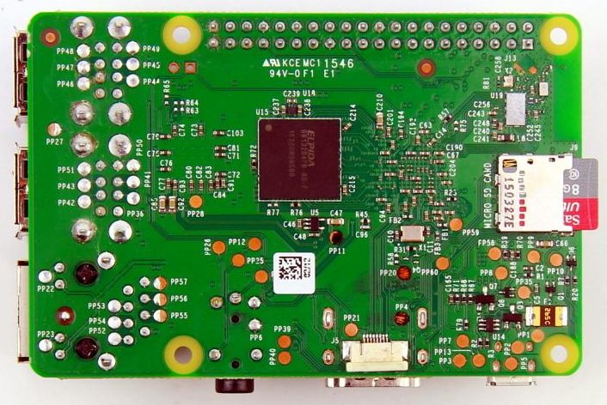
Raspberry Pi 3 - Underside

Slide 9
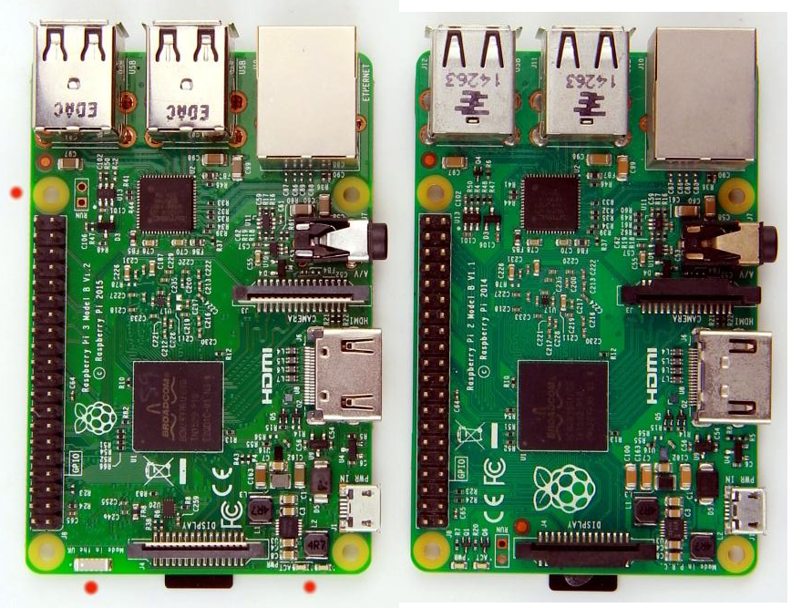
Raspberry Pi 3 compared to Pi 2
Pi3
Pi2

Slide 10
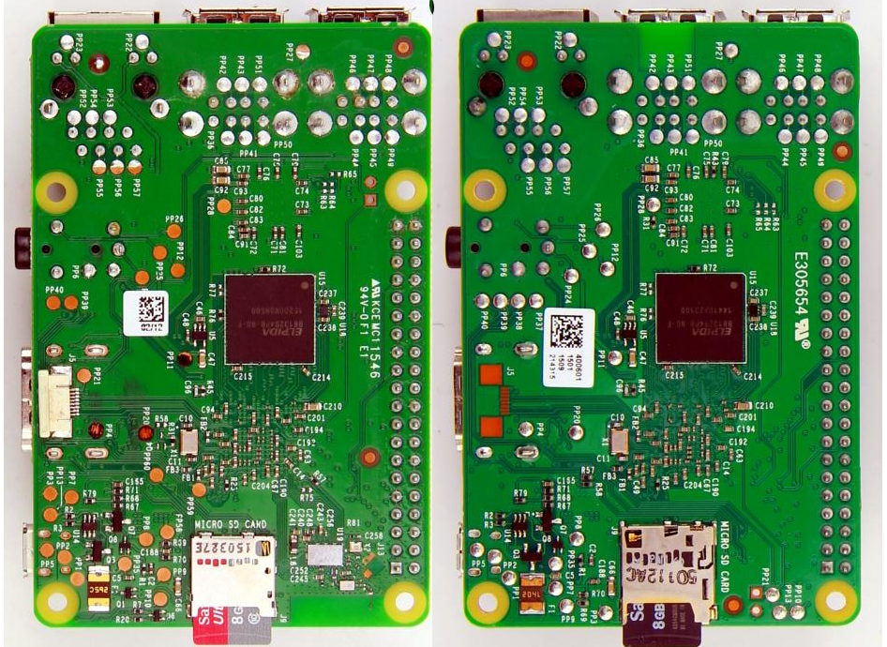
Raspberry Pi 3 compared to Pi 2
Pi2
Pi3
Pi2

Slide 11
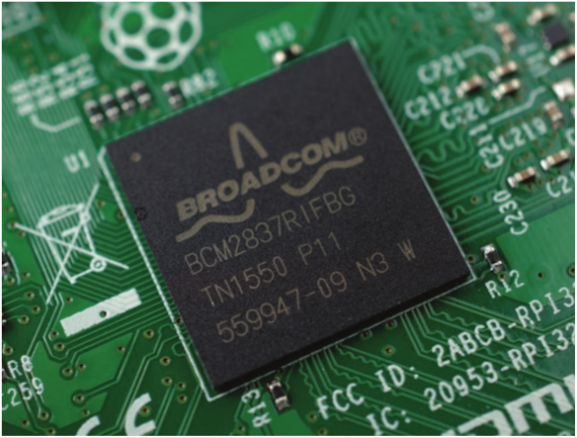
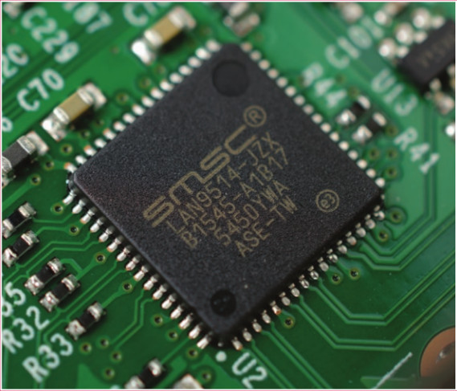
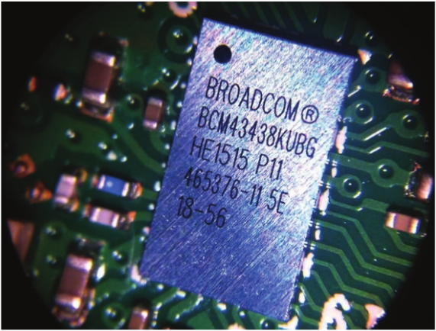
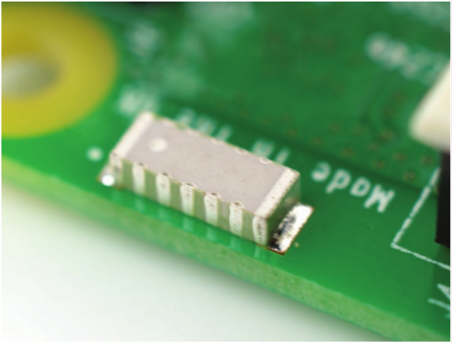
Soc, LAN/USB, wifi/bluetooth, antenna

Slide 12
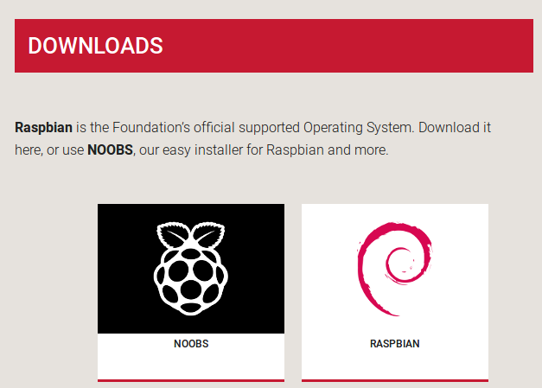
Raspberry Pi 3 - Distros

Slide 13
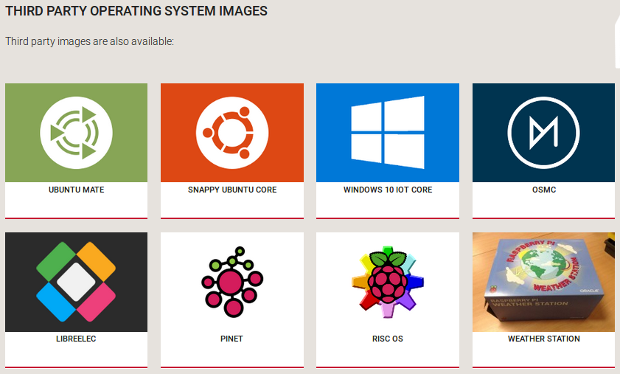
Raspberry Pi 3 - Distros

Slide 14
Raspberry Pi 3 - Price
Personal Use: PB-Tech or pishop.nz $69 (incl. GST)
Business Use: Element14 $58.30 + $8.74 GST = $67.04
PB-Tech Kit: Raspberry Pi 3 Model B Kit with OS (16GB SD Card), ( Include Raspberry Pi 3 Mainboard, 2.5A adapter, Official Pi 3 Red & White Enclosure, Official 16GB NOOBS SD Card) $125.35 (incl.GST)

Slide 15
Raspberry Pi 3 - Demo
Raspbian distro
bluetooth keyboard
Ubuntu-Mate distro
Boot for the first time – See what happens!
Add bluetooth keyboard
For directly booting a USB stick see:https://www.raspberrypi.org/documentation/hardware/raspberrypi/bootmodes/msd.md

Slide 16
Raspberry Pi 3
End

